Slide 1
Nigeria COVID-19 Data Analysis using Python
The Executive Summary Report

Slide 2
Coronavirus disease (COVID-19) is an infectious disease caused by a newly discovered coronavirus, and it has affected major parts of the world. Nigeria, a West-African country, has also been affected by the COVID-19 pandemic after recording its first case on 27th February 2020. Nigeria is a country with 37 states - Federal Capital Territory included- and a fast-growing economic environment with about 220 million citizens. COVID-19 has affected several country activities as the country steadily progressed from its first case to shutting down major airports, state-wide lockdown, curfews, and reviving its economy.
The purpose of this analysis is to show the impact of COVID-19 on our Country population, economy of Nigerian States in term of budget reallocation and adjustment.
The data can help the government of Nigeria prepare the economy better for a future pandemics
Public health system and disease control can use the data for effective planning using its information on the facilities related to COVID-19 in the Nigerian States.

Slide 3
Data SOURCE FOR THE PROJECT
Data Source for the project
The data source is divided into different parts:
The Nigeria Centre for Diseases Control (NCDC) monitors the country’s COVID-19 situation, and releases data on metrics across all the 37 states in the country. From NCDC COVID-19 official website
The Johns Hopkins University Center for Systems Science and Engineering (JHU CSSE) publishes daily data on confirmed, death and recovered cases across different countries. Nigeria daily data can easily be accessed from their repository to derive related insights.
Nigeria Community Vulnerability Index data
The vulnerability index was computed by considering several factors such as socio-economic status, population density, housing type, transportation, epidemiological, health system etc, these factors are known as themes. Each theme was broken into subthemes, and data was gathered from them to compute the overall vulnerability index score by weighing equally each theme. We make use of data index to determine relationships and correlations in this analysis.

Slide 4
Note that:
- “vulnerability” refers to the impact of the virus on a community after the virus arrives.
- It ranks from Very Low(0) to Very High(1+)
For more information, refer to the Data Dictionary.
Resource Link - Click Here
Real Domestic Gross Product Data
The Real Domestic Gross Product (GDP) data for Nigeria can be found below. This data help us help us determine the impact of COVID-19 on the economy and this can be achieve by comparing the Real GDP(Pre-COVID-19) with Real GDP(During COVID-19).
- Read more https://www.aljazeera.com/news/2020/11/21/nigeria-slips-into-recession-blamed-on-covid-19-and-oil-prices
- https://www.pwc.com/ng/en/assets/pdf/economic-alert-october-2020.pdf
State Budget Data

Slide 5
Data collection
The datasets were collected through web scraping of different sources with different features
The Global COVID-19 cases contain the daily updates of confirmed, recovered and death cases from John Hopkins Repo
The NCDC data consists of laboratory confirmed cases, patients on admission, number of patients discharged, number of death cases of COVID-19 per state in Nigeria
There are external dataset which includes: Budget(Initial and Revised) data, RealGDP data and covid_external dataset.

Slide 6
Exploratory data analysis(eda)
Exploratory data analysis helps us to summarize the main characteristics of the infectious disease and how it has affected the country by using visual methods. The purpose of exploratory data analysis include:
To Gain maximum insight into the data set and its underlying structure.
Identification of variables and data types.
Analyzing the basic metrics.
Non-Graphical Univariate Analysis.
Graphical Univariate Analysis.
Bivariate Analysis.
Variable transformations.
Check for missing data and other mistakes
Outlier treatment.

Slide 7
Data visualization
After the EDA processing, we realized there are no missing data from all the data collected. The next thing we did was data visualization to get more insight on the data we are working on. The first set of data we will be visualizing is the Global Confirmed cases, Global discharged cases and Global Death cases, Then we extract the Nigeria data from the Global cases.
Followed by the NCDC data to know which state has the highest rate of COVID-19 and how it has affected the Budget and the RealGDP.

Slide 8
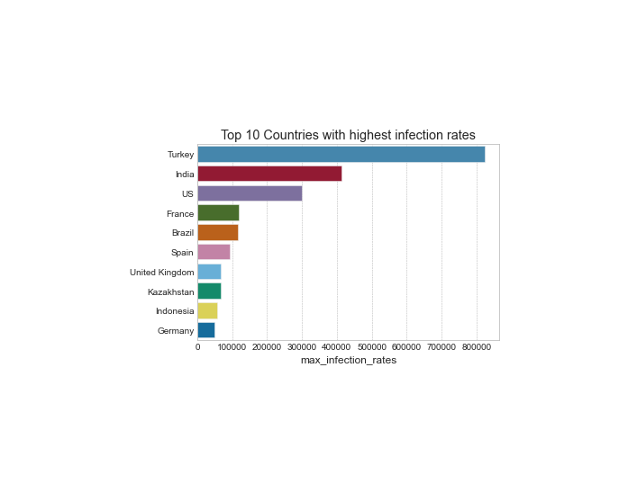
Top 10 countries with highest rate of covid-19
The Johns Hopkins University Center for Systems Science and Engineering (JHU CSSE) publishes daily data on confirmed, death and recovered cases across different countries. The chart besides this text displayed the Top 10 countries with the highest COVID-19 infection rates from the Global confirmed cases. The Global confirmed cases were the cases confirmed by Lab. The First country with the highest infection rate is Turkey, followed by India and US.

Slide 9
From Johns Hopkins University repository, we were able to extract Nigeria data from the Global confirmed cases, recovered and death dataset to get more insight and show the daily cases confirmed by date.
From CHART 1A, CHART 1B, CHART 1C below showed that there was no case of COVID -19 recorded throughout January and February of year 2020.
From CHART 2 AND 3 below displayed the Daily and Quarterly COVID-19 rate in Nigeria from March 2020-July 2021. And it was discovered that there was a spike in the first Quarter (Jan-Mar.) 2021.
From April-July 2021, we can as well see that the rate of COVID-19 infection went down drastically.

Slide 10
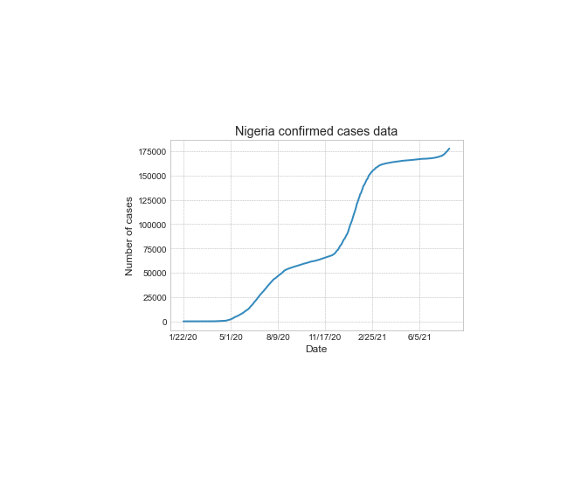
Chart 1A: Nigeria confirmed cases dataset

Slide 11
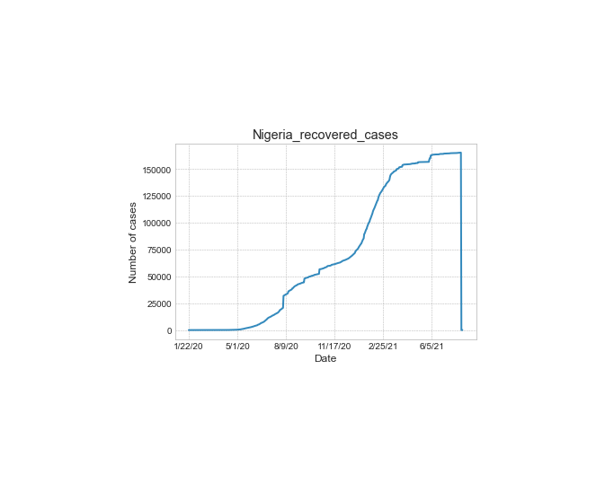
CHART 1B: Nigeria recovered cases from global data

Slide 12
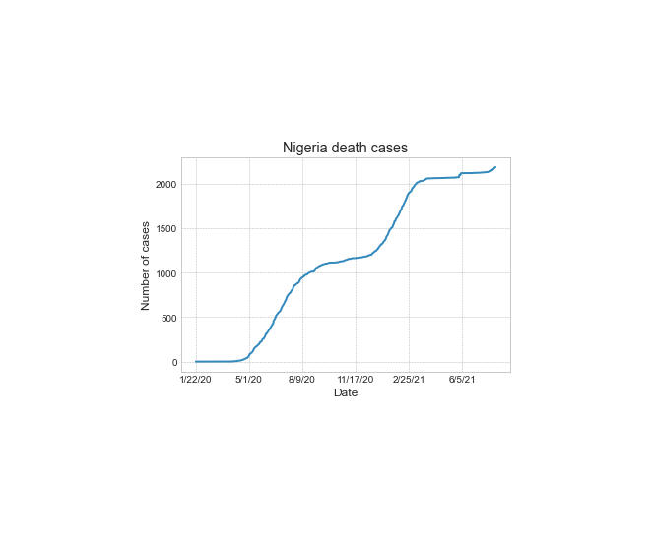
CHART 1C: Nigeria Death cases from global data

Slide 13
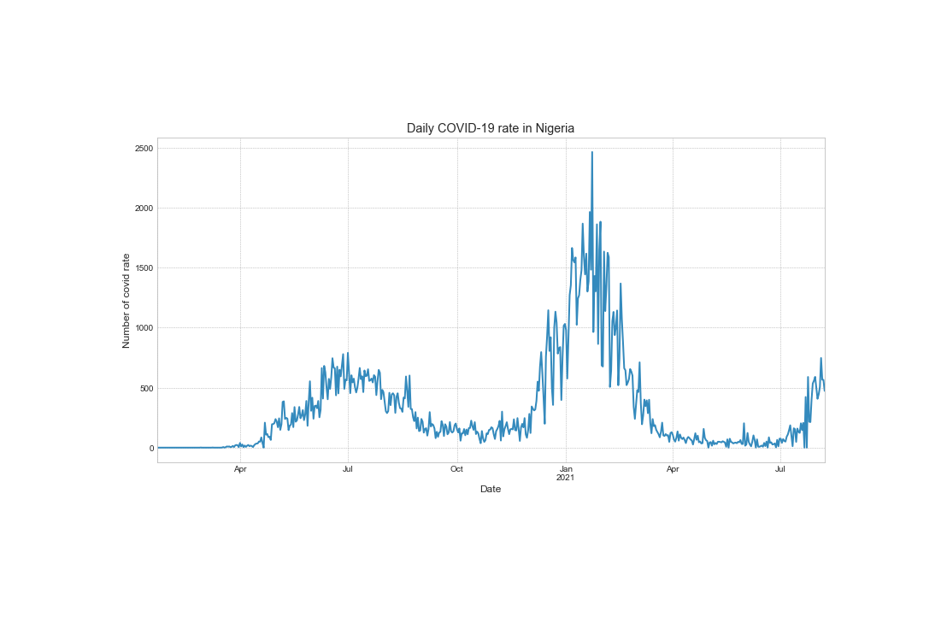
CHART2: Daily chart of covid-19 rate in Nigeria

Slide 14
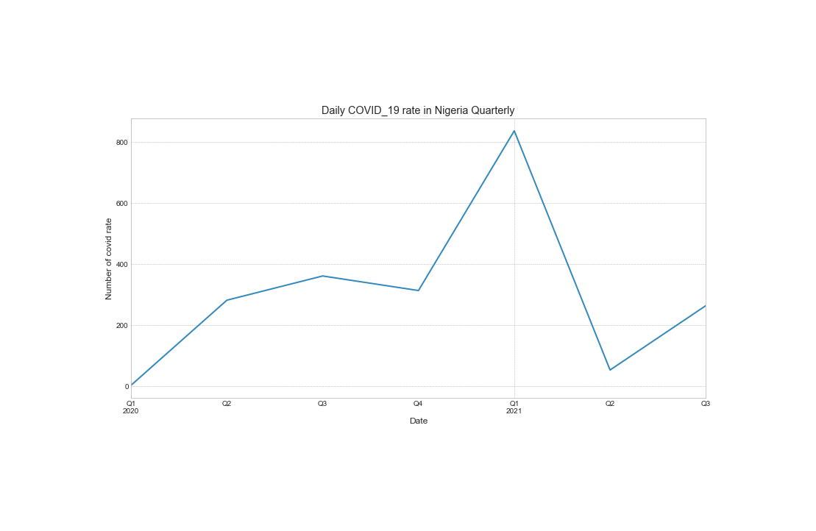
CHART3: Quarterly chart of covid-19 rate in Nigeria

Slide 16
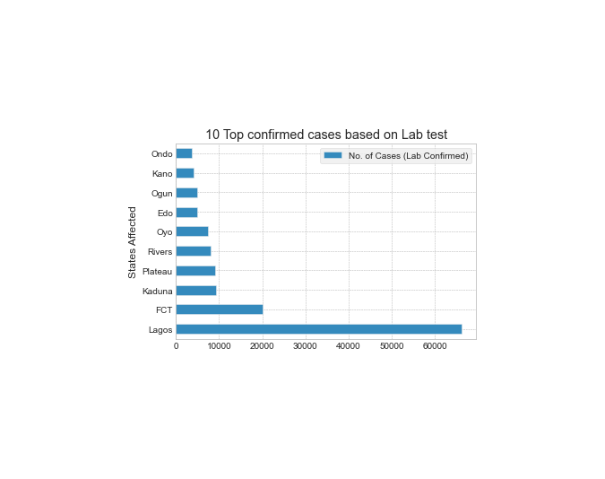
TOP 10 CONFIRMED CASES BASED ON LAB TEST

Slide 17
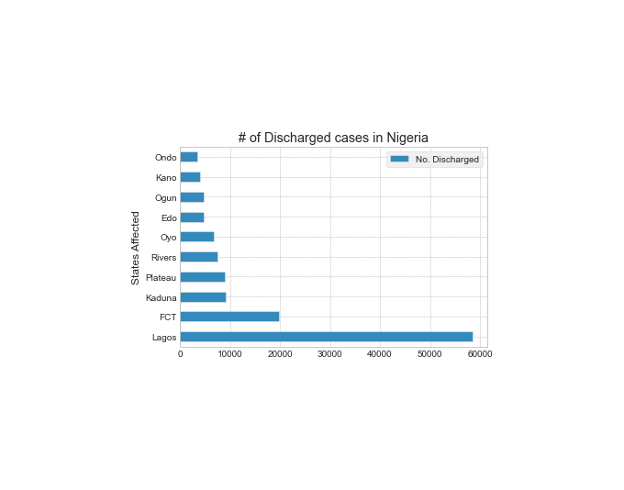
NUMBER OF DISCHARGED CASES IN NIGERIA

Slide 18
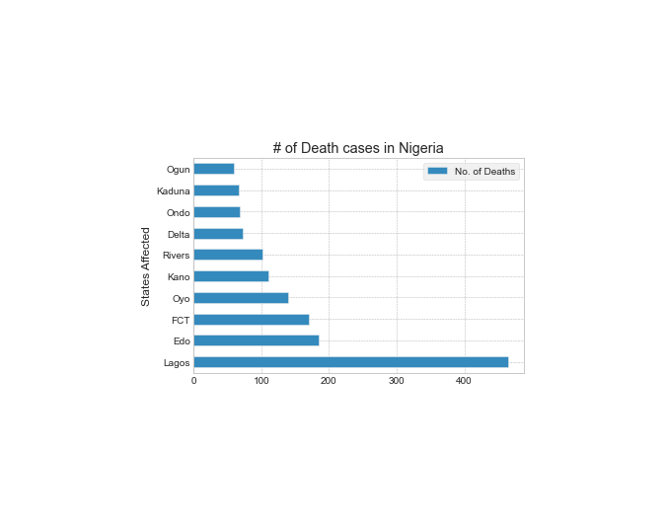
NUMBER OF DEATH CASES IN NIGERIA

Slide 19
Budget ANALYSIS
Before the incidence of COVID-19 in Nigeria, all the 36 states including the FCT had presented 2020 budgets to their respective House of Assemblies while some had even signed the appropriation bill into law. According to the data that we collated for the initial 2020 states budget, the 36 states and FCT had budgeted a total sum of N10.220 trillion for 2020 compared to the total sum of N9.140 trillion budgeted in 2019. The following states; Lagos, Cross River, Akwa Ibom, Rivers, Ogun states in the order of budget ranking has the highest budget total of N4.35843 trillion as shown
The top five states that have the highest initial budget are Lagos (N1.68 trillion), Cross River (N1.1 trillion), Akwa Ibom (N597.73 billion), Rivers (N530.8 billion) and Ogun (N449.9 billion)
While the top 5 states with the highest revised budget due to COVID-19 are Lagos (N920.5 billion), Akwa Ibom (N366 billion), Rivers (N300.4 billion), Delta (N282.3 billion) and Ogun (N280 billion). This suggests that COVID-19 really affected the Cross River state economy forcing them to reduce their budget by 86.63%

Slide 20
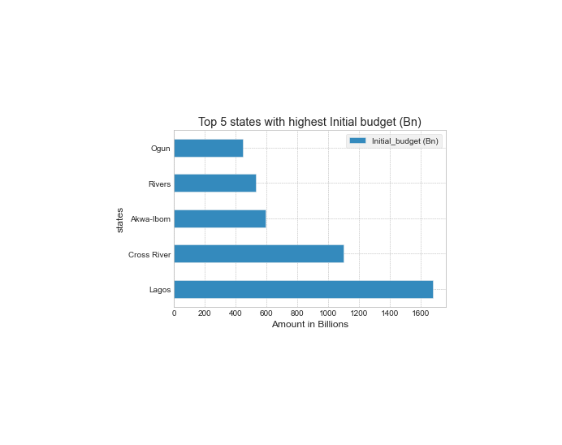
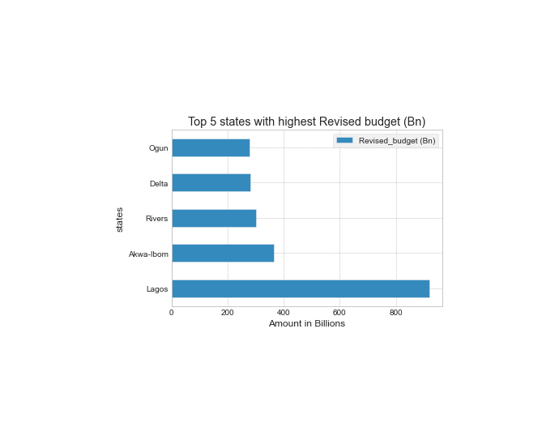
COMPARISON between initial and revised budget
Initial Budget
Revised budget

Slide 21
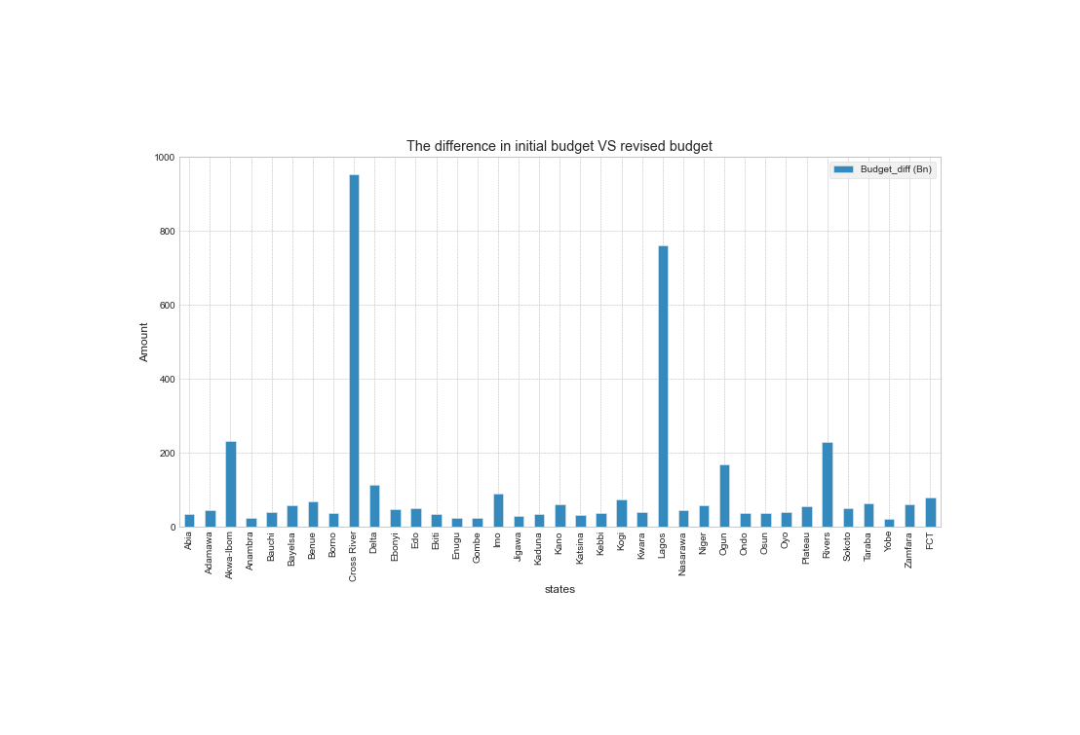
The difference in initial and revised budget for each states

Slide 22
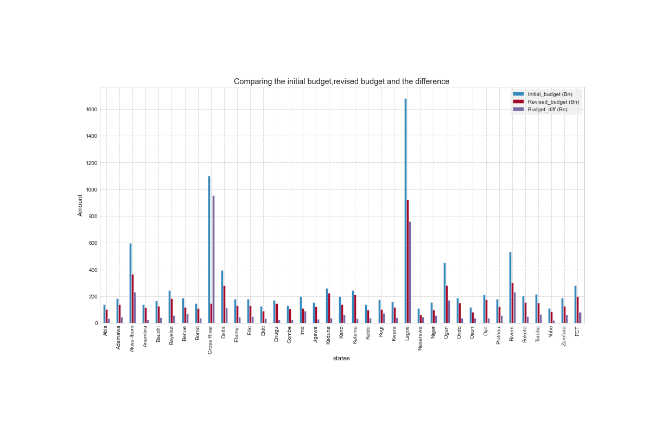
COMPARING INITIAL,REVISED AND THE DIFFERENCES IN BUDGET

Slide 23
Real gdp (Gross domestic product)
GDP is important because it gives information about the size of the economy and how an economy is performing. The growth rate of real GDP is often used as an indicator of the general health of the economy. In broad terms, an increase in real GDP is interpreted as a sign that the economy is doing well.
The gross domestic product (GDP) measures of national income and output for a given country's economy. The gross domestic product (GDP) is equal to the total expenditures for all final goods and services produced within the country in a stipulated period of time.
In 2016, Nigeria's real gross domestic product decreased by around -1.62 percent compared to the previous year.
While in 2017, 2018, 2019 Nigeria's real gross domestic product increased by around 0.81, 1.92, 2.21 percent respectively compared to the previous year.
In 2020, the Real GDP drops down by around 1.79 percent compared to the previous year due to COVID-19.
The chart below show the GDP from 2014-2020.

Slide 24
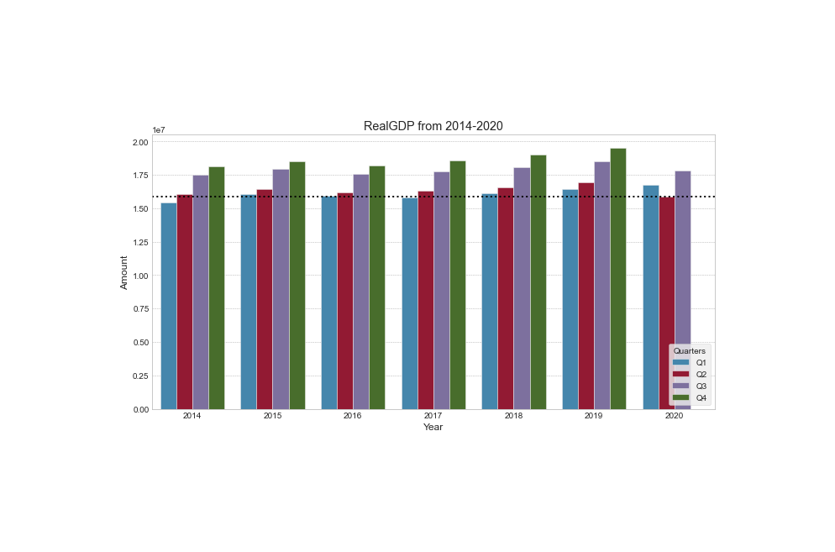

Slide 25
Showing correlation between ncdc dataset and some external dataset containing covid-19 related features
The variables that get studied with correlational research help us to find the direction and strength of each relationship. This advantage makes it possible to narrow the findings in future studies as needed to determine causation experimentally as needed.
Not only can we measure this relationship but we can also use one variable to predict the other. The correlation coefficient takes on values ranging between +1 and -1
0 indicates no linear relationship.
+1 indicates a perfect positive linear relationship: as one variable increases in its values, the other variable also increases in its values via an exact linear rule.
-1 indicates a perfect negative linear relationship: as one variable increases in its values, the other variable decreases in its values via an exact linear rule.
Values between 0 and 0.3 (0 and -0.3) indicate a weak positive (negative) linear relationship via a shaky linear rule.
Values between 0.3 and 0.7 (-0.3 and -0.7) indicate a moderate positive (negative) linear relationship via a fuzzy-firm linear rule.
Values between 0.7 and 1.0 (-0.7 and -1.0) indicate a strong positive (negative) linear relationship via a firm linear rule.
The chart below shows the correlation between some features from the data collected from NCDC website.

Slide 26
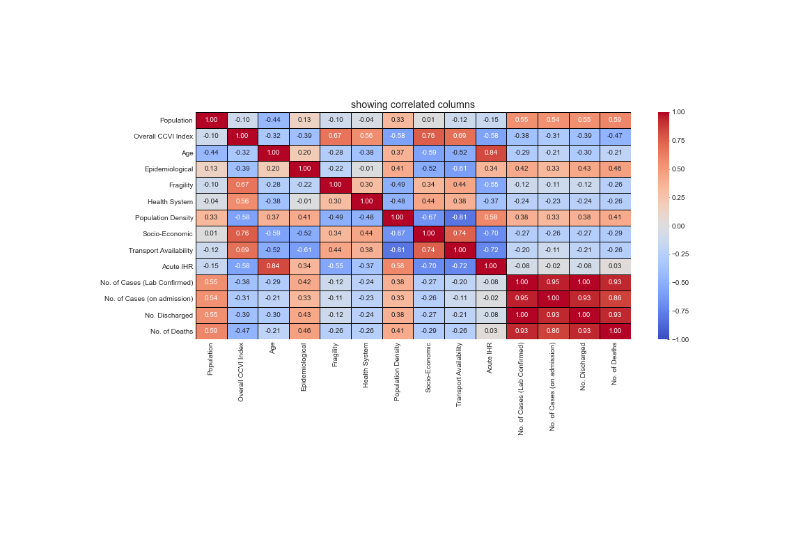
Correlation features

Slide 27
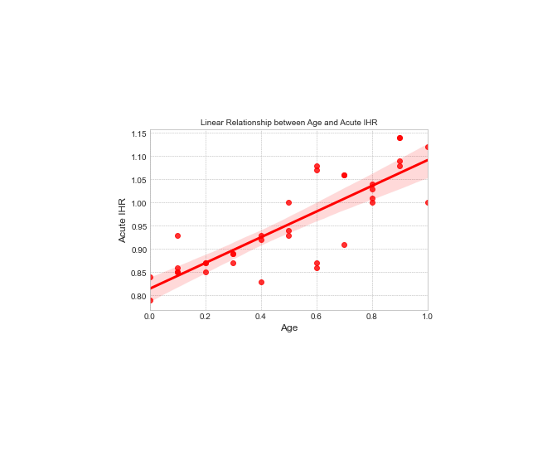
Linear relationship between age and acute ihr features(0.84)

Slide 28
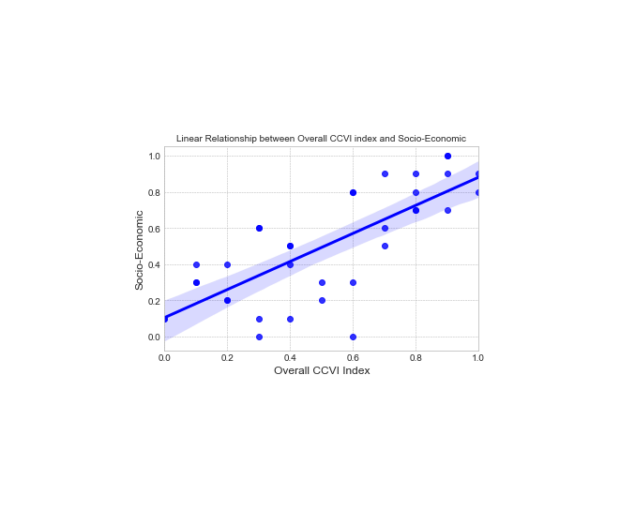
Linear relationship between Overall ccvi and socio-economic features(0.76)

Slide 29
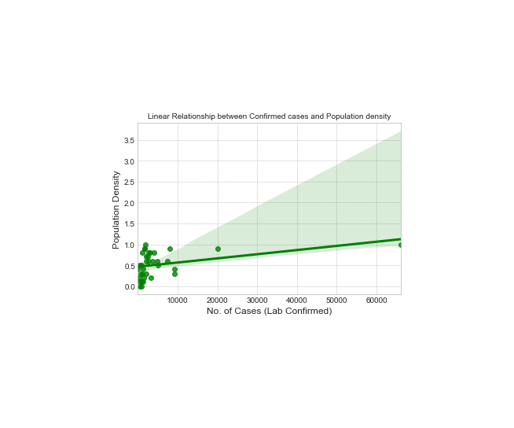
Linear relationship between population density and confirmed cases by lab features(0.38)

Slide 30
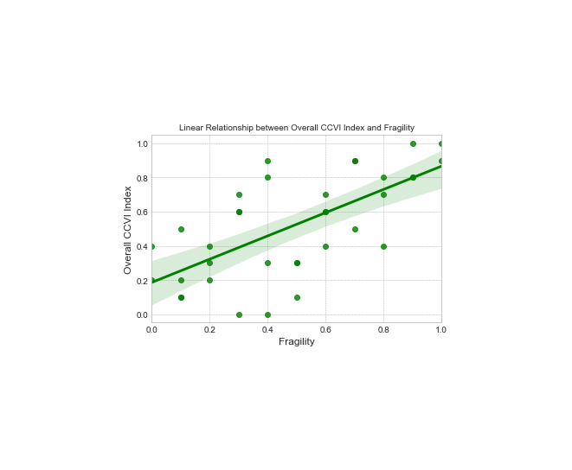
Linear relationship between overall ccvi and fragility features(0.67)

Slide 31
CONCLUSION
The current study showed that the spread of COVID-19 in Nigeria is expected to move downward. Forecasts have shown that spread of COVID-19 confirmed and recovered cases in each states in Nigeria can progressively increase on a daily basis if the citizens follows the COVID guidelines regularly.
Data visualization presented above gives us more information on how this deathly infection has affected our Economy, Health system, GDP, Education.
In addition, this results could be useful in contributing to health policy decisions or government interventions—especially in the case of a significant third wave of COVID-19. However, these results should be used in conjunction with the results from other more complex mathematical and epidemiological analysis.
In the future work, we hope to get more data on daily vaccination data, Education system in Nigeria, population for the last 5 years, Isolation center available in each state along with the fee and more external data.

